Slide 1
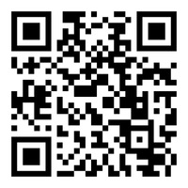
The Freedom Fight
Equipping Meeting
Add Church name
Add Date
FF Resources
Notes:
Good Afternoon. If you haven't taken a picture of this QR Code this is what will give you access to a number of free resources including this slide deck I will be presenting today so you don't have to write everything down if you're a note taker.
When I went into the ministry 33 years ago I promise you I had no aspiration to become the porn guy. And my wife had no aspirations to be married to the porn guy but it was birthed out of necessity...
…Through this process, we identified the key principles that were biblical based, scientifically informed, gospel centered and effective. And we started using these with our students and staff and saw that not only were they finding freedom but deep discipleship took place.
I felt compelled in 2015 to put these principles in a more user-friendly format as a discipleship resource (I went through the training of a CSAT)and we launched the FF in 2017 we added the app in 2018 with many iterations since then. More about this D’ship tool later. The writer of Hebrews commands…

Slide 2
“Let us also lay aside every weight, and sin which clings so closely, and let us run with endurance the race that is set before us. Fixing our eyes on Jesus…”
Hebrews 12:1-2b
Notes:
I don’t know of a heavier weight or a more entangling sin sideling God’s people from God’s purposes like pornography. The ultimate goal isn’t freedom but it’s to run free after Christ and His purposes.
-As I mentioned earlier, later in this breakout, I will show you some free resource that you can start using immediately in your discipleship to help those you work with in this area. But before we look at solutions, we need to grasp some brutal realities about porn’s impact because it will deepen our convictions to address this issue in our discipleship as well as help us understand the solutions that follow.

Slide 3
The Brutal Realities of Porn’s Impact
Notes:
The first brutal reality is the most obvious…

Slide 4

It’s Pervasive
Notes:
Pervasive-Barna just released their latest stats on porn use in the church.

Slide 5

Practicing Christian Men Who Watch Porn
78% of all generations
Nine out of ten Gen Z & Millennial men (18-43)
More than half watch daily or weekly
*Barna survey, 2024
Notes:
These are stats for practicing Christians. A practicing Christian is defined as a Christian who strongly agrees that their faith is very important to them and they attend church regularly. Of the practicing Christian men…
but for the younger generation it's even higher
Let these stats sink in. These are the next generation of Christian husband, fathers, pastors and leaders being discipled by porn.
Its not just a man’s issue…

Slide 6

Practicing Christian Women Who Watch Porn
34% of all generations
Seven out of ten Gen Z & Millennials (18-43)
One in five watch daily or weekly
*Barna survey, 2024
Notes:
These are our future Christian wives and mom’s women's leaders in the church being discipled by pornography.
-Ok--Let me take a poll of these stats. How many of you are surprised at how high these numbers are?
--What you expected?
--Anyone surprised at how low these are?
The 2nd brutal reality is that its…

Slide 7
Of Practicing Christians who use porn…
49% are comfortable with the amount of porn they use
21% want to consume less (but some is ok)
Only 21% want to quit porn completely
*Barna survey, 2024

Slide 8
People Want Help - But Aren’t Getting It
84 percent of reported porn users say they don't have anyone in their life helping them avoid pornography.
Six in ten congregants say it is important to them that their church is addressing topics like pornography and sexually compulsive behavior.
*Barna survey, 2024

Slide 9
It’s Destructive

Slide 10
“Abstain from fleshly lusts which wage war against the soul.”
1 Peter 2:11
Notes:
When God wanted to describe how fleshly lust, like porn, impacts a person, He used warfare imagery and He says it wages war against the deepest part of who we are. There has been some amazing research done illustrating this out of the University of Oklahoma. There was a six year study of 3000 people looking at the impact of pornography use and it shows that pornography is waging war on multiple fronts. The first is…

Slide 11
Porn is Waging War Against…
Spiritual Growth
“Any porn use… is associated with declines in religious commitment and behavior (i.e. attending services, prayer, etc.) and an increase in religious doubts.”
- Dr. Samuel Perry
Notes:
Think about it, if you wanted Christians to be less committed to praying, reading their Bible and going to church and you wanted them to doubt more, just get them to watch porn.
-Listen to doubts of this missionary who had to come home from the mission field because of his struggle with porn.

Slide 12
I don’t see any victory in the area of porn-I mean is my faith real? I’m reading my Bible about power over sin. Meanwhile, I cannot shake this thing, and I have no idea what in the world to do about it.
Overseas Missionary
Notes:
Dr. Perry’s study found that porn is also waging war against…

Slide 13
Porn is Waging War Against…
Marriages
Porn users are 2-3 times more likely to divorce in the next two years than the porn-free couple.
One of the best predictors of divorce for a person is the depth of their porn habit.
A couple who watches porn is 318% more likely to commit adultery.
Notes:
And our younger generation has the deepest porn habit of any generation in our nations history. Our youth need to know that porn sets their future marriage up for failure.
Dr. Perry’s research also found that porn use wages war against…

Slide 14
Porn is Waging War Against…
Kingdom Service
More Porn = Less Service
Notes:
The correlation he found was...
The more porn someone watches the less likely they were to serve in their congregation.

Slide 15
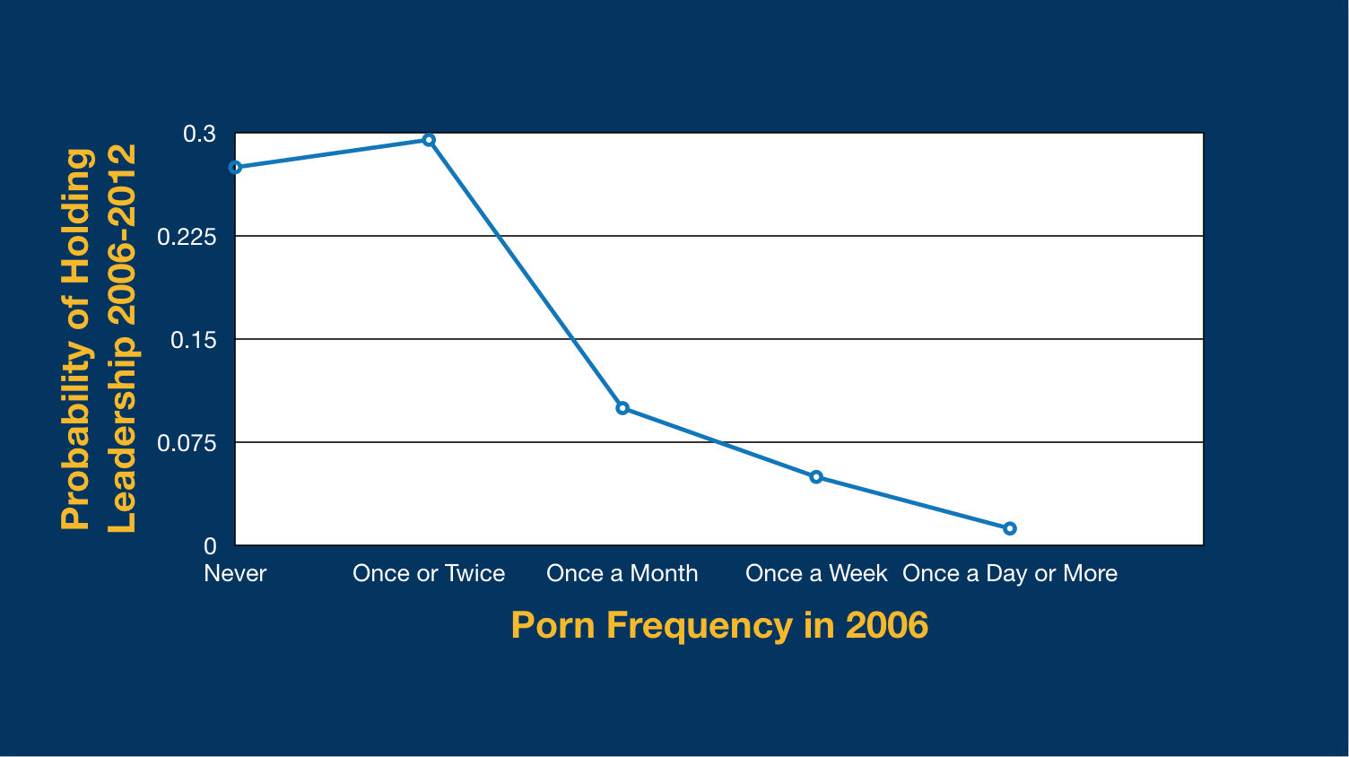
Pornography and the Leadership Crisis
1 in 3
1 in 10
1 in 20
Dr. Samuel Perry
DR. SAMUEL PERRY
Notes:
If someone didn't watch porn they had a 1 in 3 probability of serving.
If they started watching porn monthly their probability of serving dropped to 1 in 10. If they watched weekly it was 1 in 20 and if they started watching daily it was almost zero.
Listen to this former lay leader.

Slide 16
A few years ago, I stopped taking opportunities to lead groups at church or disciple younger men because of where I am personally with porn. I’d really feel like a worthless hypocrite for teaching some young men about how to study the Bible and share their faith when I’m regularly looking at pornography.
Former lay leader
Notes:
Remember what Paul told Timothy…

Slide 17
“But the goal of our instruction is love from a pure heart and a good conscience and a sincere faith.
1 Timothy 1:5
Notes:
Porn use is waging war against a pure heart, a good conscience and a sincere faith and is taking so many laborers our of the harvest whether they are missionaries or lay leaders.
Finally Dr. Perry’s research showed that porn is also waging war against…

Slide 18
Porn is Waging War Against…
Godly Parenting
More Porn = Less spiritual interaction with kids

Slide 19
Porn is Waging War Against…
Godly Parenting
Findings suggest that increased pornography consumption might threaten the transmission of religious heritage from parents (particularly fathers) to children.
-Dr. Samuel Perry

Slide 20
Spiritual Growth
Any porn use is associated with declines in religious commitments (e.g., prayer, attending services) and an increase in religious doubts.
…abstain from the passions of the flesh, which wage war against your soul.
~1 Peter 2:11
A 6-year peer-reviewed study of 3,000 people* showed porn use wages war in 4 key areas…
Marriage
If either spouse starts watching porn, divorce is 2–3x more likely than for a porn-free couple.
Kingdom Service
As porn use increases, willingness to serve in the church declines.
Godly Parenting
The more frequently someone watches porn, the less likely they are to be close to their kids or talk to them about faith.
*Perry & Hayward, “Seeing Is (Not) Believing,” Social Forces 95:4 (2017)
Notes:
This six year study is an illustration of what 1 Peter 2:11
Turn to the person next to you and discuss of these 4 areas that porn is waging war against which is most alarming to you and why?
-We are in a spiritual battle and our enemy is using porn to reach into Christian homes and churches and capturing the hearts and minds of a generation.
-Porn is also waging war against...

Slide 21
Porn is Waging War Against…
Healthy Sexuality
Porn users are less sexually satisfied than non-users.
Notes:
Not surprising when they grow up with unrealistic expectations about what sex is.

Slide 22
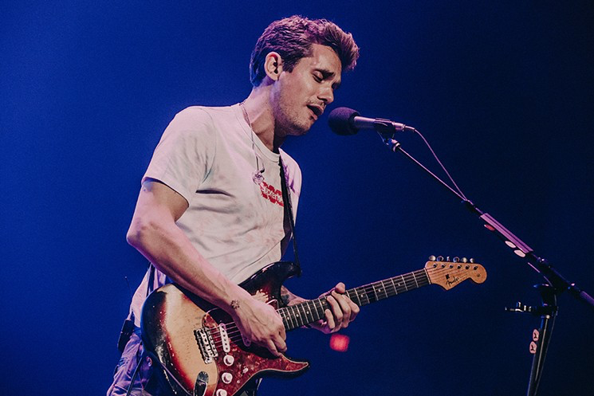
Notes:
Musician John Mayer admitted in an interview that he actually prefers fantasy and masturbation to sex with a woman. Through all his porn use he unknowingly rewired his brain on what arouses him. This is what we are seeing in a generation of youth—their arousal template is being shaped by porn and self-stimulation which is a very different experience than healthy marital sex.
-This rewiring of the arousal template has resulted in a how new phenomenon among young men--

Slide 23
Porn is Waging War Against…
Healthy Sexuality
Porn users are less sexually satisfied than non-users.
Porn-Induced Erectile Dysfunction.
Notes:
This is the cover story of TIME magazine in 2016

Slide 24
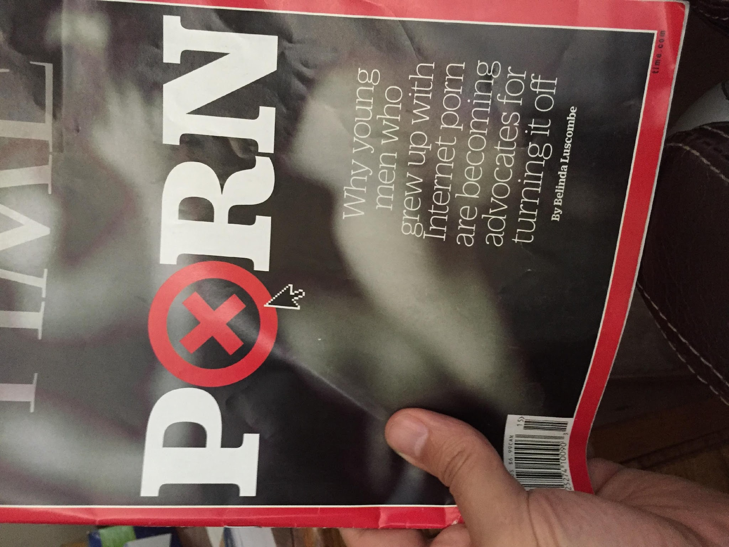
Notes:
If you read the article, its about a bunch of 20 somethings saying, why didn't anyone tell us that porn was going to ruin our sex life.
The article went on to say...

Slide 25
In 1992, only 5% of men under forty had E.D., but by 2014, it went to 33%
Notes:
-1 out of 3 men under 40 struggle with ED. We are seeing it in teenagers as young as 15.
-Another impact of porn is...

Slide 26
Porn is Waging War Against…
Healthy Sexuality
Porn users are less sexually satisfied than non-users.
Porn-Induced Erectile Dysfunction.
Porn can change your sexual preferences.
Notes:
A Study of 11K porn users found that there was a direct correlation between the frequency of porn use and those who consider themselves bi-sexual.

Slide 27
Of those who watch porn:
Weekly - 13% say they’re bisexual
Daily - 20% say they’re bisexual
Multiple Times Daily - 27% say they’re bisexual
Notes:
When someone reaches a point of tolerance with drugs or alcohol you need more to get the same high but with porn you don't just need more you need different. And the different you need is a little more deviant, taboo and forbidden. This is the escalating nature of porn and why we are seeing stats like this.

Slide 28
From 2010-2020 child pornography arrests increased 2500% from the previous decade.
Notes:
When a person starts chasing the dopamine high they will find themselves watching things they never thought they would watch or doing things they never thought they would do.

Slide 29
“The thief comes only to steal and kill and destroy. I came that they may have life and have it abundantly.”
John 10:10
Notes:
We have an enemy who promises sexual satisfaction through porn but with it, he is actually stealing, killing and destroying in many cases even the ability to enjoy the real thing.
Porn is not just pervasive and destructive but...

Slide 30
It’s Addictive

Slide 31
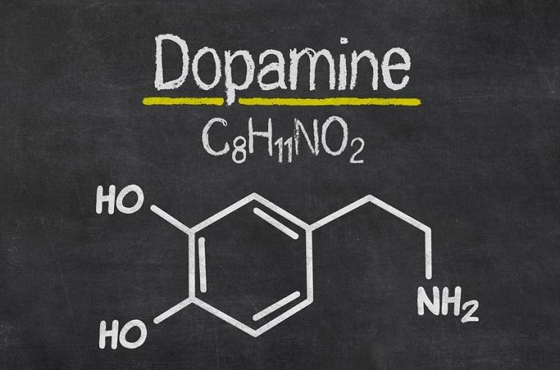
Notes:
Dopamine is the pleasure chemical that our brains release when we experience pleasure that our brain wants us to remember and repeat. Drugs like cocaine artificially raise the level of dopamine in the brain and so does pornography.

Slide 32
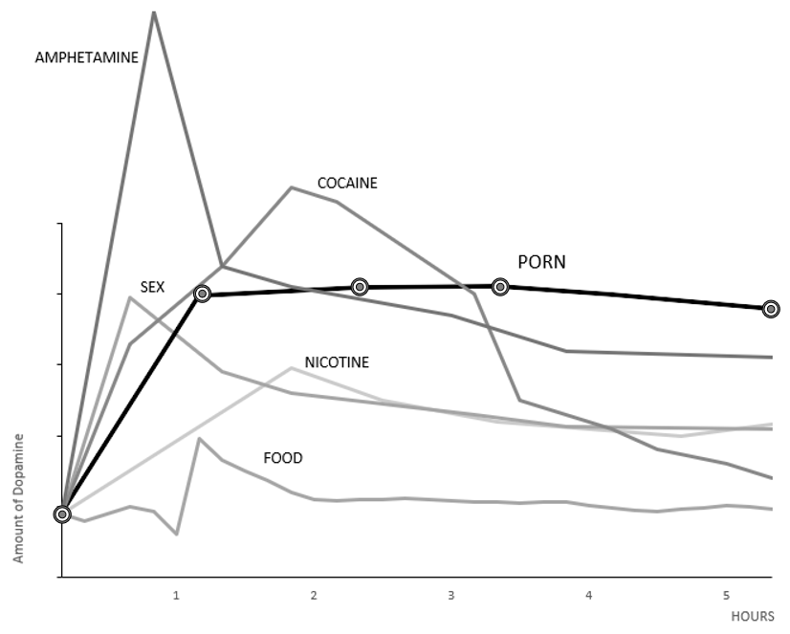
Notes:
This graph shows different stimulates and the estimated amounts of dopamine they produce in the brain. --Sex is the highest natural reward that our brain gives. God wants us to remember and repeat sex within marriage where it was intended to be thoroughly enjoyed. --There are 3 stimulants estimated to produce more dopamine in the brain than sex--meth, cocaine and porn. Sex and porn are at about the same level but nothing compares to a maintaining a dopamine high near its peak. Most porn sessions last minutes but hours long binge sessions are common. --Addiction experts tell us...

Slide 33
How an addiction is born
Notes:
When a person starts using their dopamine to medicate their negative emotions and they do that repeatedly that is when an addiction can take root.
So, for instance. If I use porn numb my stress and I do that over and over then the next time I'm stressed--you know what the brain does? It releases dopamine to start the craving to go down that porn pathway. The brain goes into relief mode and it know where to go to feel a whole lot better. Men I work with will often think an urge to use porn hits them out of nowhere but usually when we go back and look at it, its an emotional trigger that they have learned to medicate.
-Porn has become a person's refuge when they have negative emotions. It is their idol and god they go to for comfort. But not just for comfort but for validation when they experience rejection or failure--its a place they can go to feel significant and enough in the fantasy world of porn. Most guys' biggest trigger to use porn is failure, disappointment and rejection.
-But porn also offers fake intimacy. It's a place where they always feel wanted, desired and connected and vulnerable and it usually involves climaxing which releases oxytocin and there is a literal emotional bond that develops b/t the person & porn. Together...
--As idols go porn is hard to beat--it makes me feel better when I'm down, or stressed or anxious, it makes me feel significant and enough when I'm I feel like a failure, it makes me feel wanted and desired and loved when I'm lonely. And the best part is its always there any time I need it. This is the a counterfeit church. IMO-This is THE false god that the majority of practicing Christians in our churches are bowing down to.
--Well-all this dopamine being released at unnaturally high levels changes the brain...

Slide 34
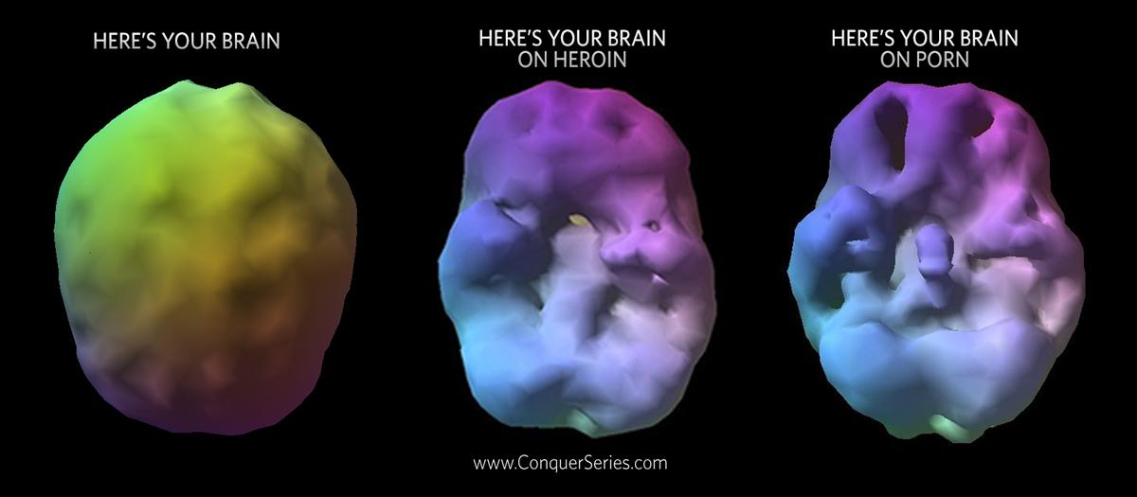
Notes:
Dr. Lawerence Tucker’s brain scans of a healthy brain compared to the addicted brain on heroin and porn and they show the degradation of the brain’s frontal lobe. The prefrontal cortex is where we make moral decisions and have impulse control—these are our brakes. But through prolonged pornography use and the elevated levels of dopamine, this part of the brain gets less blood flow and oxygen and therefore doesn’t operate effectively. Our brakes aren’t working and the addiction is in the driver’s seat. This is why people who are addicted to substances can make such dumb decisions. God puts an asterisk by sexual sin...

Slide 35
Flee from sexual immorality. All other sins a person commits are outside the body, but whoever sins sexually, sins against their own body.
1 Corinthians 6:18
Notes:
One way I believe we can sin against ourselves is our brains lock us into bondage and we find ourselves bond to things or people that we wish we weren't bond to.
And here is the scary part, the adolescent brain is the most vulnerable.

Slide 36
According to recent research 90% of adults who are addicted to alcohol, tobacco or drugs started using their addictive substance before they were 18.
Health Day News
Notes:
If someone gets hooked on an addictive substance before they are 18, the chances that it becomes a life long struggle go way up. This is why we have laws in place to keep addictive substances away from the adolescent brain. And yet when it comes to porn and parents are giving their 12 or 13 year old one of these...

Slide 37
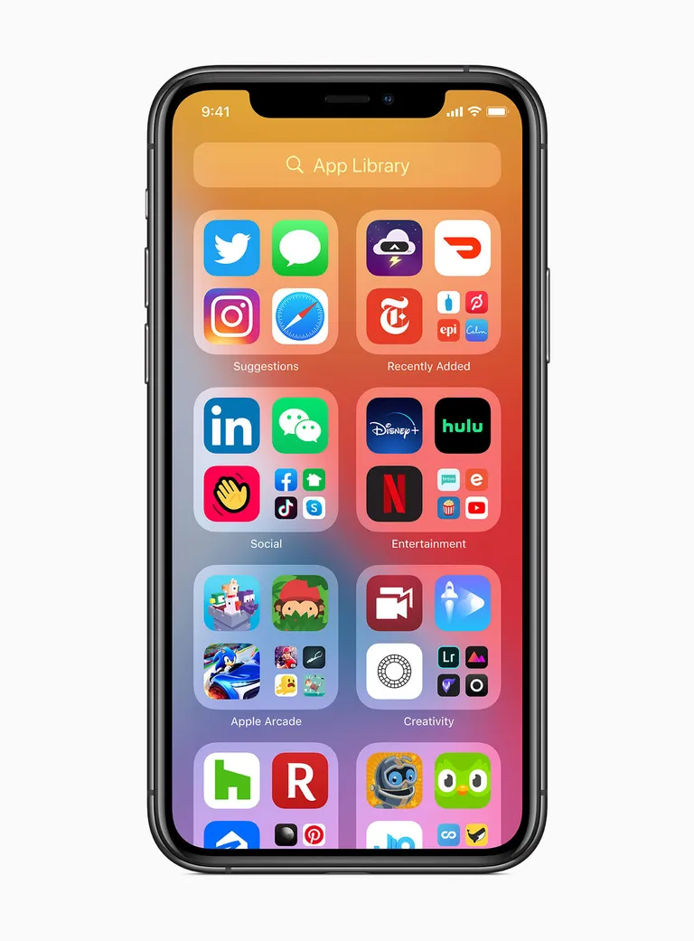
Notes:
They have no idea that they are giving access to one of the more addictive substances on the planet. Those of us who work with college students have a front row seat to the reality that each year the freshmen class shows up with deeper and deeper addictions to porn and typically the parents have no idea.
-On a positive note: the adolescent brain can also snap back and build new pathways in the brain because it is more moldable or neuroplastic. So educating our youth is critical so they can get serious about finding freedom before their 25. You can find freedom after that for sure--it is just more challenging. -Who knew visual lust was going to be so destructive?

Slide 38
Now this I say and testify in the Lord, that you must no longer walk as the Gentiles do
Ephesians 4:17
Notes:
"You must no longer” indicates that it was a current ongoing issue. In v.19 Paul describes the behavior of the Gentiles that many of the Ephesians were walking in.

Slide 39
You have heard that it was said, ‘You shall not commit adultery.’ But I say to you that everyone who looks at a woman with lustful intent has already committed adultery with her in his heart. If your right eye causes you to sin, tear it out and throw it away.
Matthew 5:27-29
Notes:
Jesus warns us that visual lust is such a big deal that we need to get radical in cutting off access to it. But most practicing Christians don't think so.
-Barna's study found that of the practicing Christian men who watch pornography---What percentage want to get porn completely out of their life? We hope it would be 100% but what would you guess?
Only 21%. Half of the group said they are comfortable with the amount of porn they are watching and another 20% said they wanted to decrease the amount(but some is ok).
Apparently, a lot of believers don't know Jesus' standard & need to be educated.
-Of the 7 churches in Revelation that Jesus evaluates, He rebukes two of them because of immorality(porniea) in the Church. The church leaders at Thyatira got rebuked not because they themselves were immoral but because they refused to address it in the church. Check it out.

Slide 40

Nevertheless, I have this against you: You tolerate that woman Jezebel, who calls herself a prophet. By her teaching she misleads my servants into sexual immorality (porneua).
Revelation 2:20
Notes:
So, think about it. These leaders are rebuked because there is an influence in the church that is misleading God's servants into sexual immorality (porneua) and the church leadership is...

Slide 41
Nevertheless, I have this against you: You tolerate that woman Jezebel, who calls herself a prophet. By her teaching she misleads my servants into sexual immorality (porneua).
Revelation 2:20
Notes:
tolerating it. They aren't addressing it. Isn't that what's happening right now?--
-There has never been an influence like internet pornography misleading God's people into immorality and yet the vast majority of church and ministry leaders tolerate it.
-In light of the spiritual warfare, the destruction and the idolatry being unleashed through porn we would expect our spiritual leaders to be all over this and yet. The latest Barna research found that...

Slide 42
9%
of churches have a resource to address pornography*
only
*Barna survey 2024
Notes:
Why do you think most pastors and churches don't address this issue.
-There are a lot of reasons but a few of the key reasons...
-Many pastors themselves are struggling-In my book I cite 2 separate studies that say 54% of pastors struggle with porn. If you are struggling you won't be very effective at equipping your flock in the area.
-Many pastors and churches don't understand how pervasive, destructive and idolatrous porn actually is. They need some education.
-For the churches who want to address the issue-- Shame makes it a difficult. Ie. the booth in the back. When its only a recovery issue only a small % of the people who need help will show up.
-We coach churches to make this not just a recovery issue but a discipleship issue. A recovery issue is only for those with big problems but discipleship is for everyone. As an example at the end of the sermon instead of inviting the porn addicts straight into porn addiction recovery at the booth in the back,

Slide 43
Following Christ in a
Pornified World
Learn how pornography is pervasive, destructive, and addictive and how we can be equipped to guard against it ourselves and help others find freedom from it.
Notes:
What if you invited them to an equipping meeting with this title. Where you can educate them on the issue through this slide deck I'm taking you through--and will give it to anyone who wants it.
-You could call the equipping meeting whatever you wanted.
-You can make the training geared toward any group in the church whether that’s youth, parents, men, women or even a churchwide equipping meeting. You could describe the meeting like this...
-At the end of this meeting you will invite to a 30 DC a 5 week equipping class so they can grow in their own purity and get equipped to help others break free from a porn addiction. More on the 30 DC at the end.
-The apostle Paul made addressing sexual immorality(porneia) part of his discipleship and so should we. One of the places Paul addresses it is Ephesians 4.

Slide 44
Walk in a Manner Worthy
Ephesians 4:17-27
Notes:
Paul begins this passage...

Slide 45
Now this I say and testify in the Lord, that you must no longer walk as the Gentiles do
Ephesians 4:17
Notes:
Paul commands the Ephesian believer to quit living like the lost people around them.

Slide 46
Now this I say and testify in the Lord, that you must no longer walk as the Gentiles do
Ephesians 4:17
Notes:
"You must no longer” indicates that it was a current ongoing issue. In v.19 Paul describes the behavior of the Gentiles that many of the Ephesians were walking in.

Slide 47
They have become callous and have given themselves up to sensuality, greedy to practice every kind of impurity. But that is not the way you learned Christ!
Ephesians 4:19-20
Notes:
Sensuality literally means unbridled lust. When someone’s unbridled lust is in control, look what results. They are “greedy to practice every kind of impurity”. If you wanted to describe a modern-day sex addiction it’s hard to do better than the CSB translation of this verse:

Slide 48
They gave themselves over to promiscuity for the practice of every kind of impurity with a desire for more and more.
Ephesians 4:19-20 CSB
Notes:
But then Paul reminds the Eph. that this isn't who they are

Slide 49
They have become callous and have given themselves up to sensuality, greedy to practice every kind of impurity. But that is not the way you learned Christ!
Ephesians 4:19-20
Notes:
Paul calls the Ephesians to repent from walking the path of the Gentiles in immorality and to walk a new path that is in line with their identity in Christ. Notice what Paul doesn’t say. He doesn’t say to this group of Christians stuck in sexual bondage. Just try harder and pray more. He doesn't give Christian cliques but instead Paul gives six commands for how the Ephesians can walk a new path of freedom that leads them to the fullness of their identity in Christ. Just as there are certain practices that keep us stuck in our old life and identity, there are also practices that will help us live our new life in Christ. This is important...
... because when we exhort others to leave sexual sin behind without a clear pathway to freedom it can multiply the shame for the believer who has tried and failed and begged God to take this desire away only to fail again. -Paul called the Ephesians to repent and he gives them six areas to grow in in order to walk in freedom. These are the six areas the FF program is built on. So real quick let me run through these and show how we apply these principles in our program for someone stuck in porn or other sexual sin.

Slide 50
People don’t rise to the level of their goals but they fall to the level of their systems.
James Clear, Atomic Habits
Notes:
The apostle Paul cast a grand vision of our identity in Christ in the first 3 chapters but now he is gets very practical about how to build the habits(or system-if you will) that will make living out of our identity in Christ a lifestyle.
-These principles can be applied to any sin that keeps a person entangled in their old life. I don’t know of a passage of scripture that gives more practical instructions for walking in freedom from sexual sin and living out of an identity in Christ than this one.
Paul uses the analogy of changing clothing--putting off the old and putting on the new. The new things Paul commands us to put on, deal with 6 growth areas.

Slide 51
Growth Area
Practical Holiness
Put on…holiness (v. 24)
Notes:
Separating from sin and specifically closing access to porn and triggering media is a first step in the process. We coach people on how to lock up their phone and devices but its rooted in a conviction that we pursue holiness because that’s our identity in Christ. This sin struggle is not who we are.
Next Paul commands…

Slide 52
Growth Area
Practical Holiness
Renewing the Mind
Be renewed in the spirit of your minds (v. 23)
Notes:
We teach a tool called BRACE which is an acronym showing the steps needed to build a new neurological pathway in the brain. Its based on brain science and 4 biblical principles and it has proven to be a powerful tool to renew the mind. It helps people at the point of temptation connect with God, His word and His people. -One of the ministers who went through our program said simply using BRACE tripled the amount of scripture he memorized.
-We have an I'm triggered button on our app that a person can hit & send a message to their accountabil so they can reach out & pray. Speaking of account...

Slide 53
Growth Area
Practical Holiness
Renewing the Mind
Authentic Accountability
Let each one of you speak the truth with his neighbor,
for we are members one of another (v. 25)
Notes:
Porn stunts a person's relational connections and causes them to isolate. Those who don't have deep connections in real life are more susceptible to the fake intimacy of porn or a sexual hook up. But through daily check ins on our app and check in phone calls people connect regularly and foster vulnerability and confession and walking in the light.

Slide 54
Growth Area
Practical Holiness
Renewing the Mind
Authentic Accountability
Processing Your Emotions
Be angry and do not sin; do not let the
sun go down on your anger (v. 26)
Notes:
Paul is specifically talking about dealing with and processing your anger but the principle can be applied to any negative emotions (v.26). Most people don’t realize they have emotional triggers that they medicate with porn. So growing in emotional awareness and intelligence is a key factor to finding freedom. Instead of being ruled by their emotions people learn to identify and process their emotions with God and others. This is the key part of our daily check in on the app.

Slide 55
Growth Area
Practical Holiness
Renewing the Mind
Authentic Accountability
Processing Your Emotions
Replace Lies with Truth
The truth is in Jesus…having put away falsehood, let each
one of you speak the truth with his neighbor (vv. 21, 25)
Notes:
Learning to replace lies with God’s truth is a key to walking in freedom and living out our identity in Christ. Even secular scientist say that what makes trauma so damaging are the lies people believe as a result of the trauma. Trauma is a potent delivery system for Satan's lies. Lies like I’m worthless, I’m a failure, I don’t matter, God is done with me, I’m hopeless, this trauma is my fault, etc. Lies feed a shame identity which feeds the negative emotions that the person has learned to medicate with porn. So replacing these lies with the truth of our identity in Christ is critical. The last growth area is...

Slide 56
Growth Area
Practical Holiness
Renewing the Mind
Authentic Accountability
Processing Your Emotions
Replace Lies with Truth
Living Out Your Identity in Christ
Put on the new self, created after the likeness of God (v. 24)
Notes:
All of these steps work together to help us understand and live out of our identity in Christ. One of the saddest things I see is so many believers living out of a shame identity instead of their identity as a child of the King. Each of these six growth areas is rooted in and leads to living out of our true identity in Christ. When people start believing their identity in Christ and living it by faith--it is powerful. It isn’t just head knowledge but it becomes a lifestyle. What’s incredible about these six areas of growth that the apostle Paul lays out is they just happen to address the six roots of a porn or sex addiction.

Slide 57
Growing Out of an Addiction
Roots of Addiction | → | Growth Area
A Sexualized Society | → | Practical Holiness
An Addicted Brain | → | Renewing the Mind
Isolation | → | Authentic Accountability
Negative Emotions | → | Processing Your Emotions
Trauma | → | Replace Lies with Truth
Shame | → | Living Out Your Identity in Christ
Notes:
Think about that for a minute. Paul’s solutions given to the Ephesians 2000 years ago specifically address the roots of this very modern issue of internet pornography addiction-which is incredible.
-The Freedom Fight program systematically addresses each of the roots with the solutions Paul lays out. And as we address each root, we must help people gain the knowledge, skills and convictions to outgrow porn.

Slide 58
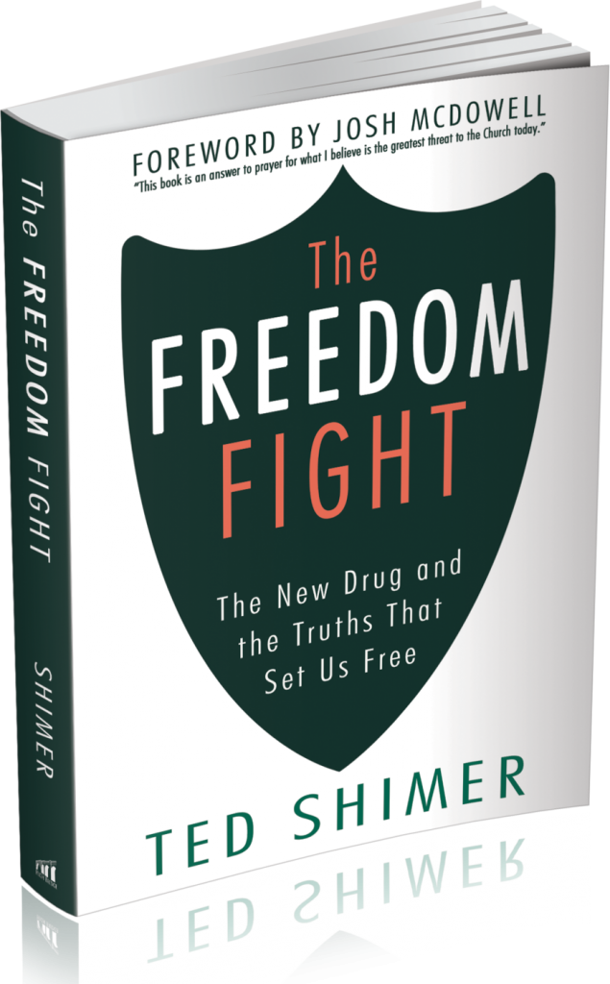
Notes:
These are being sold on Amazon. The first third of the book is about the Brutal Realities of porns impact and the second two thirds unpack the six roots of a porn addiction and how to address them.
-Our seven-month recovery/discipleship program systematically walks through these six areas of growth.

Slide 59
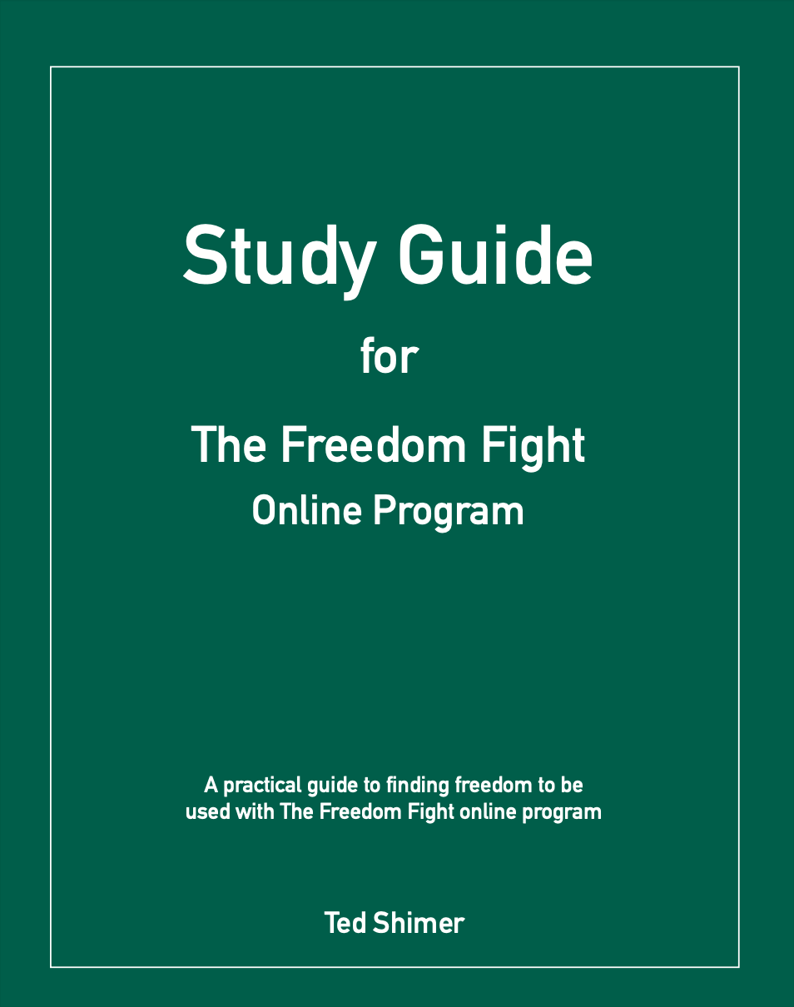
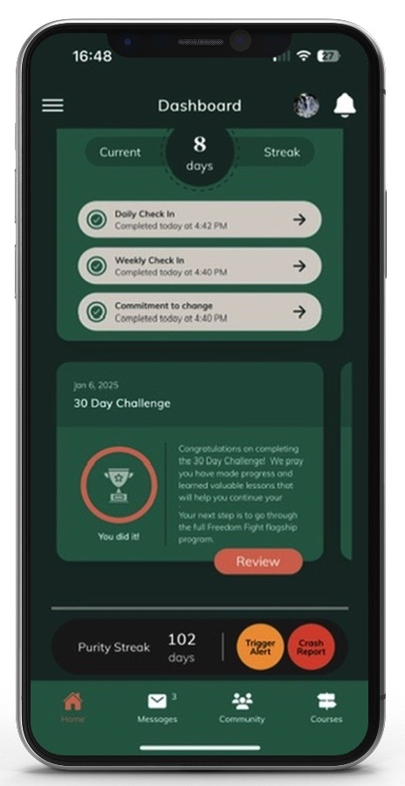
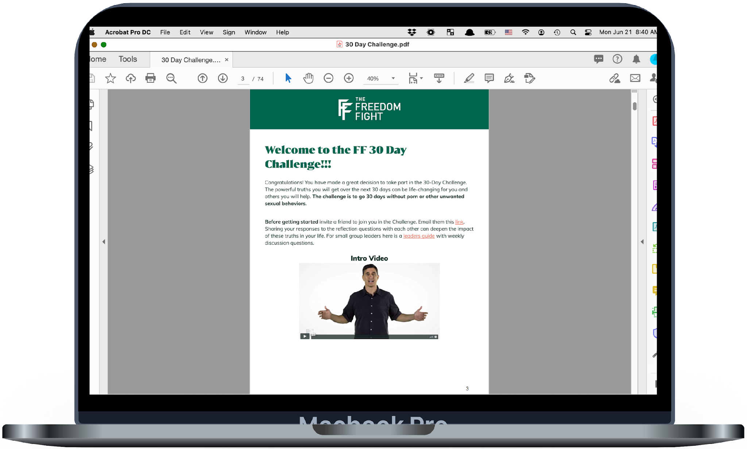
Our Discipleship Solution
50+ videos, bible studies, and addiction-recovery tools for practical application.
Biblically-based, scientifically informed, gospel centered approach.
Users stay connected and accountable through app tools and check-ins.
Notes:
Its a video based program with short 5-8 minute videos, a short Bible study with each lesson and our app to keep you connected and accountable.
-The results we are seeing have been incredible.

Slide 60
find freedom
when they finish the program and are committed to its 3 core habits.
86%
Notes:
I want to ask Cole Davis to come up and share his story of finding freedom. Cole is the engagement dir for the FF--so if you need some free coaching about how to utilize the FF in your church or ministry --he is your guy.
-We took some key lessons from our six month program and created a introductory program called The 30 Day Challenge. I want to encourage you to use this free tool.

Slide 61
Freedom Fight Resources
30 Day Challenge (free)
Notes:
-Besides the slides here are some other resources for you.
-When you download the Freedom Fight App, you’ll have access to the free 30 Day Challenge.
The 30 Challenge has a leaders guide that gives you discussion question and is a discipleship tool that you can walk through with someone individually or in a small group. You can download it from the Resources sections of the Freedom Fight App.
-If someone comes up you and tells you they are struggling with porn you have a tool you can start walking with them through in 30DC.
-If you want some deeper training on this topic...

Slide 62
Freedom Fight Resources
30 Day Challenge (free)
Leaders Certification Training
Notes:
-For you or someone in your church that wants to head this up and you want to get them some more training our Sex Addiction Discipleship Leader certification has been significant in equipping leaders at deeper level. 35 hours of self paced work online and an 8 hour zoom training that is very interactive with our FF staff and other leaders from around the country.
-Another resource is...

Slide 63
Freedom Fight Resources
30 Day Challenge (free)
Leaders Certification Training
Premium Groups
Notes:
If you or someone you know is struggling with porn, Our Premium Groups are confidential online Groups lead by a certified leader who has proven experience in leading people to freedom. This paid group also means the participants are more committed and bought in and has really helped people to further faster in finding freedom.
And finally...

Slide 64
Freedom Fight Resources
30 Day Challenge (free)
Leaders Certification Training
Premium Groups
Coaching Call (free)
www.thefreedomfight.org
Notes:
-Besides the slides here are some other resources we want to send you.
-When you sign up for the 30 DC you will get a daily email with 10 minutes or less of content. The 30 Challenge has a leaders guide that gives you discussion question and is a discipleship tool that you can walk through with someone individually or in a small group.
-If someone comes up you and tells you they are struggling with porn you have a tool you can start walking with them through in 30DC.
-If you want some deeper training on this topic...
-You can sign up for a free coaching call with our Engagement Director Cole. I know I have hit you with a ton of information and he can help you sort it out and get you connected with the right resources so you can disciple your people to freedom.
Let me close in prayer and I will be upfront and Cole will be at our booth.

