Slide 1
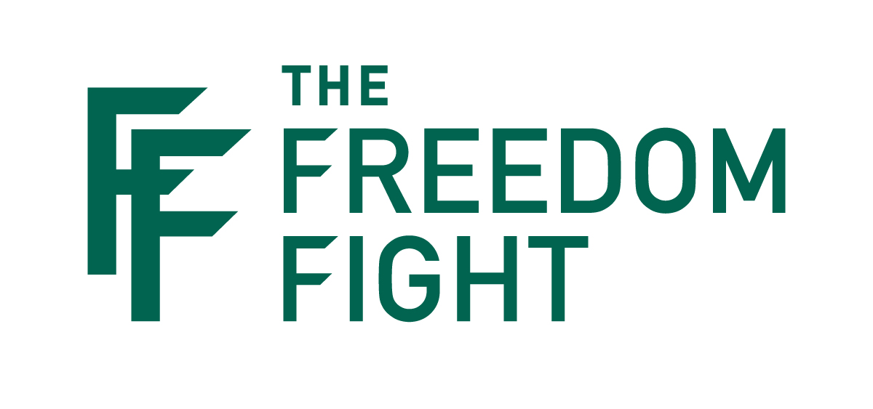

Slide 2



“Let us also lay aside every weight, and sin which so easily entangles, and let us run with endurance the race that is set before us.”
Hebrews 12:1

Slide 3

It’s Pervasive

Slide 4




Barna Group Survey
64% of Christian men use porn at least monthly
65% of non-Christian men use porn at least monthly

Slide 5


Practicing Christian College Men
• 89% watch porn at least occasionally
• 61% watch porn at least weekly.
• 24% watch porn daily or multiple times a day.

Slide 6

Practicing Christian
College Women
51% watch porn at least occasionally
24% watch porn at least monthly

Slide 7
It’s DESTRUCTIVE

Slide 8
“Abstain from fleshly lusts which wage war against the soul.”
1 Peter 2:11

Slide 9

Porn is Waging War Against…
SPIRITUAL GROWTH

Slide 10

Porn is Waging War Against…
SPIRITUAL GROWTH
“Any porn use… is associated with declines in religious commitment and behavior (i.e. attending services, prayer, etc.) and an increase in religious doubts.”
Dr. Samuel Perry

Slide 11
I don’t see any victory in the area of porn-I mean is my faith real? I’m reading my Bible about power over sin. Meanwhile, I cannot shake this thing, and I have no idea what in the world to do about it.
Overseas Missionary

Slide 12

Porn is Waging War Against…
MARRIAGES
Porn users are 2-3 times more likely to divorce in the next two years than the porn-free couple.

Slide 13
Porn is Waging War Against…
MARRIAGES
Porn users are 2-3 times more likely to divorce in the next two years than the porn-free couple.
One of the best predictors of divorce for a person is
the depth of their porn habit.

Slide 14
Porn is Waging War Against…
MARRIAGES
Porn users are 2-3 times more likely to divorce in the next two years than the porn-free couple.
One of the best predictors of divorce for a person is
the depth of their porn habit.
A couple who watches porn is 318% more likely to commit adultery.

Slide 15
Porn is Waging War Against…
KINGDOM SERVICE
MORE PORN = LESS SERVICE

Slide 16
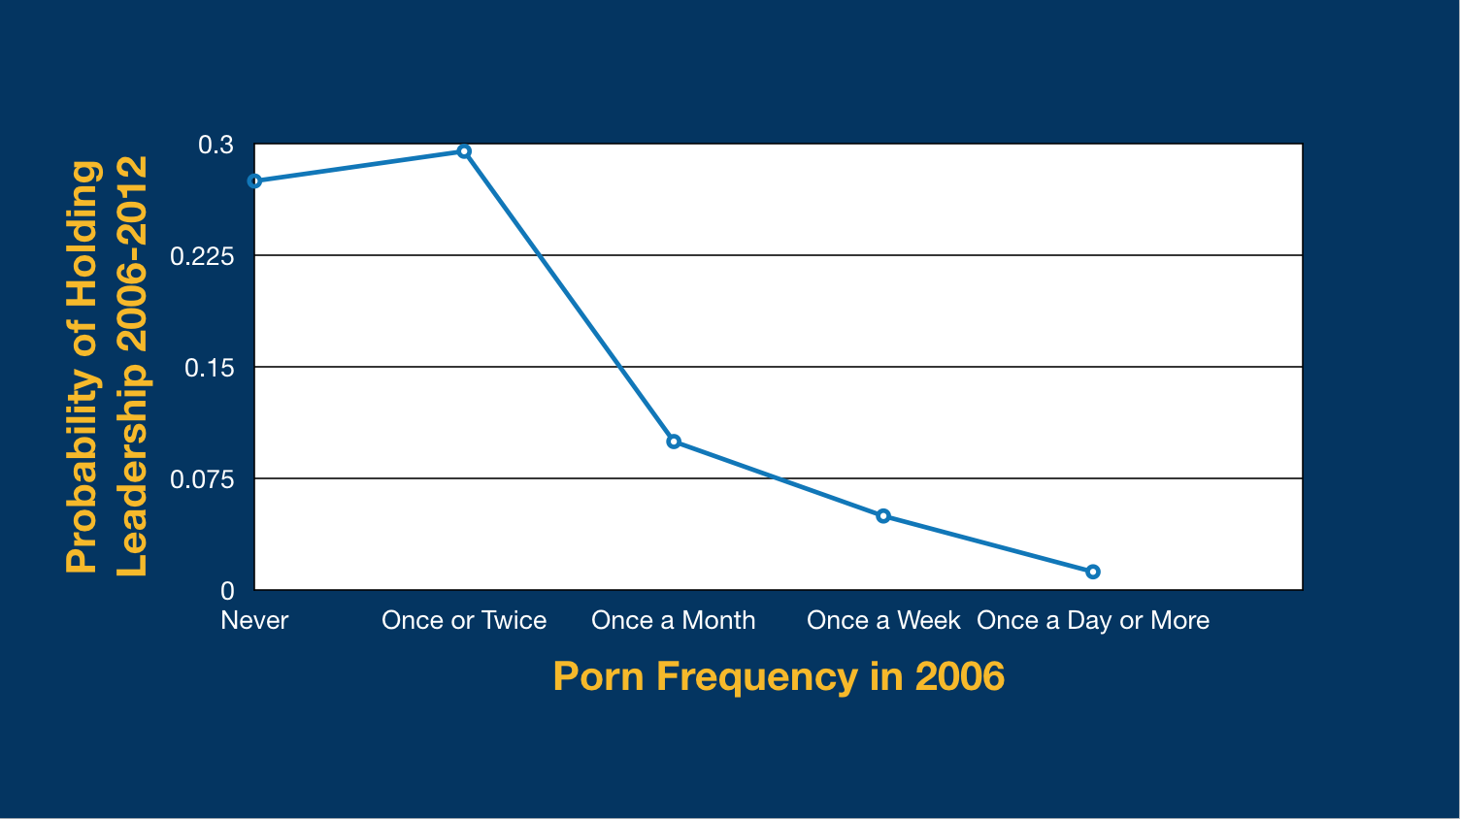
Pornography and the Leadership Crisis
1 in 3
1 in 10
1 in 20
Dr. Samuel Perry
DR. SAMUEL PERRY

Slide 17


A few years ago, I stopped taking opportunities to lead groups at church or disciple younger men because of where I am personally with porn. I’d really feel like a worthless hypocrite for teaching some young men about how to study the Bible and share their faith when I’m regularly looking at pornography.
Former lay leader

Slide 18
Porn is Waging War Against…
GODLY PARENTING
More Porn = Less spiritual interaction with kids

Slide 19
Porn is Waging War Against…
GODLY PARENTING
Findings suggest that increased pornography
consumption might threaten the transmission
of religious heritage from parents to children.
-Dr. Samuel Perry

Slide 20

Spiritual Growth
Any porn use is associated with declines in religious commitments (i.e., prayer, attending services, etc.) and an increase in religious doubts.
“…abstain from fleshly lust which wage war against the soul”
1 Peter 2:11
A 6-year peer-reviewed study of 3,000 people* showed porn use wages war in 4 key areas…
Marriage
If either spouse starts watching porn, they are 2-3 times more likely to divorce than the porn free couple.
Kingdom Service
The more frequently someone watches porn the less likely they are to serve in their church.
Godly Parenting
The more frequently someone watches porn the less likely they are to be close to their kids or talk to them about faith.
*Dr. Samuel Perry, George M. Hayward; “Seeing is (Not) Believing: How Viewing Pornography Shapes the Religious Lives of Young Americans

Slide 21
Porn is Waging War Against…
HEALTHY SEXUALITY
Porn users are less sexually satisfied than non-users.
Porn can change your sexual preferences.

Slide 22
Of those who watch porn:
WEEKLY - 13% say they’re bisexual
DAILY - 20% say they’re bisexual
MULTIPLE TIMES DAILY -27% say they’re bisexual

Slide 23
Porn is Waging War Against…
HEALTHY SEXUALITY
Porn users are less sexually satisfied than non-users.
Porn can change your sexual preferences.
Porn-Induced Erectile Dysfunction

Slide 24
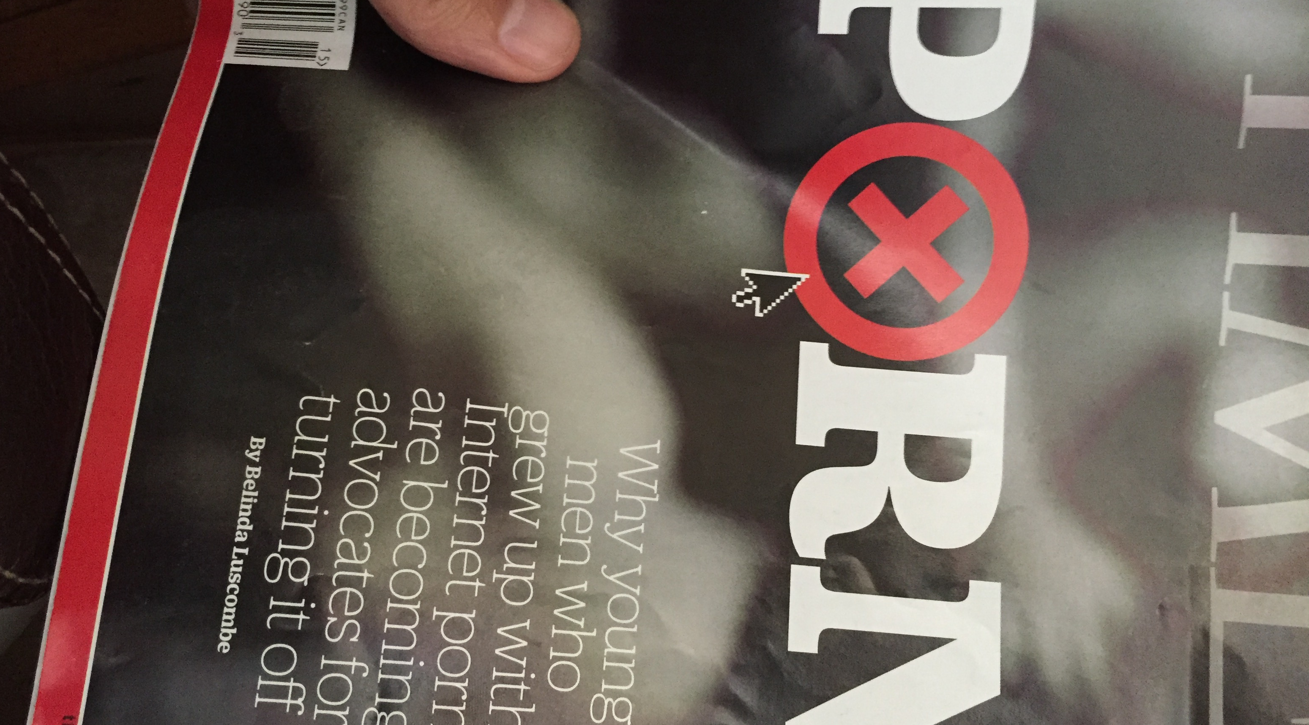

Slide 25

In 1992, only 5% of men under forty had E.D.,
but by 2014, it went to 33%

Slide 26
7%
of pastors have a resource to address pornography*
only
Freedom Fight is equipping the church and its leaders with a ready-made porn addiction recovery / discipleship solution
*Barna survey, CharismaNews 2018

Slide 27
It’s ADDICTIVE

Slide 28
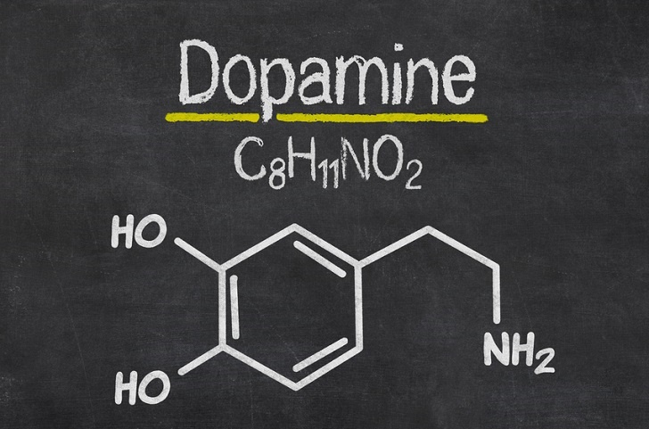

Slide 29
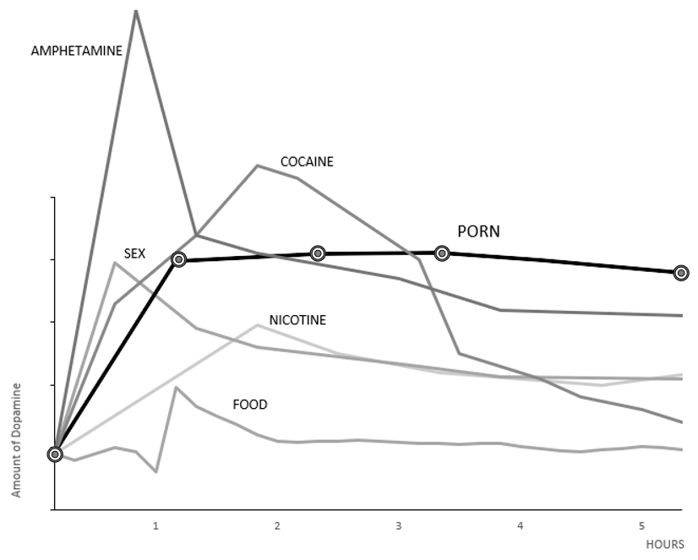

Slide 30
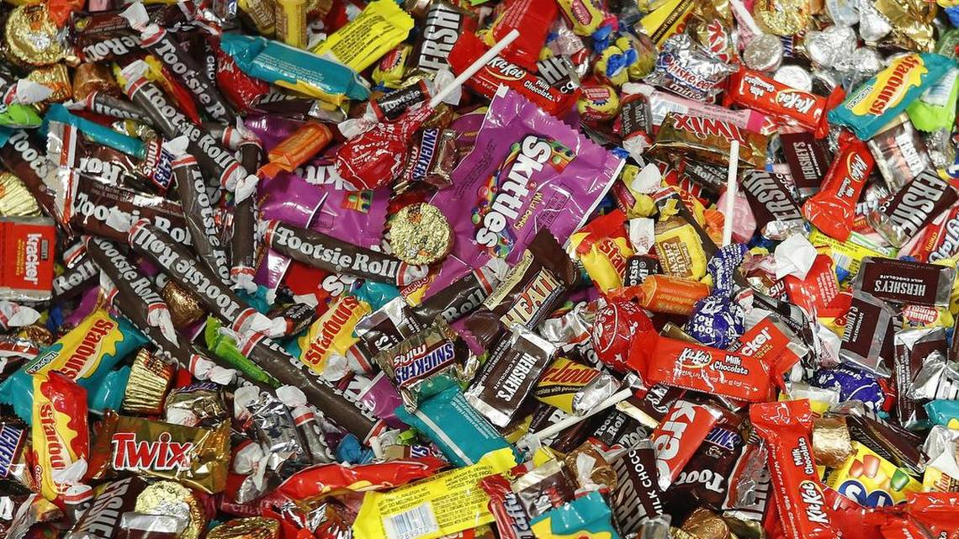

Slide 31


Slide 32
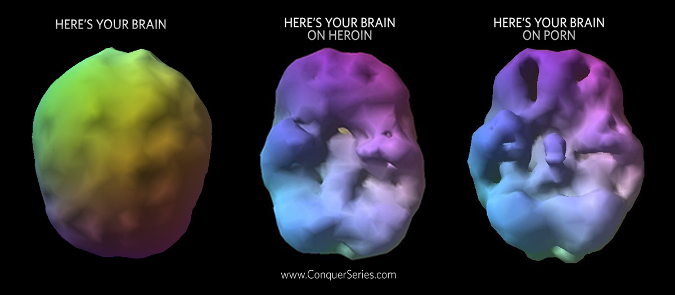

Slide 33
“Flee from sexual immorality. Every other sin a person commits is outside the body, but the sexually immoral person sins against his own body.”
1 Corinthians 6:18

Slide 34
According to recent research, 90% of adults who are addicted to alcohol, tobacco or drugs started using their addictive substance before they were 18.
Health Day News

Slide 35
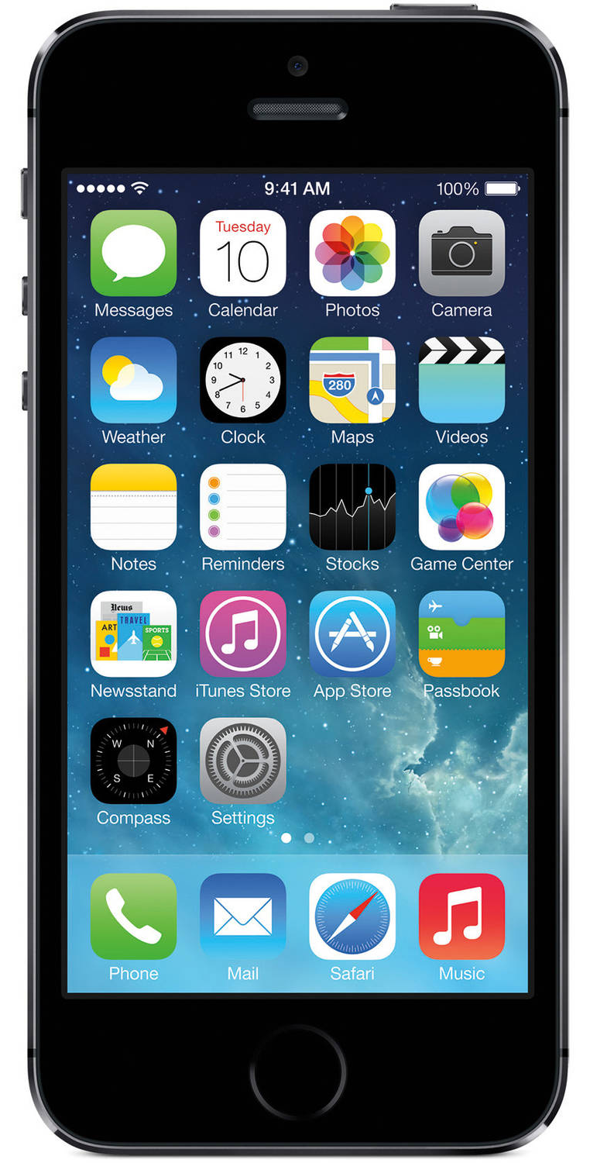

Slide 36
How an
addiction
is born

Slide 37
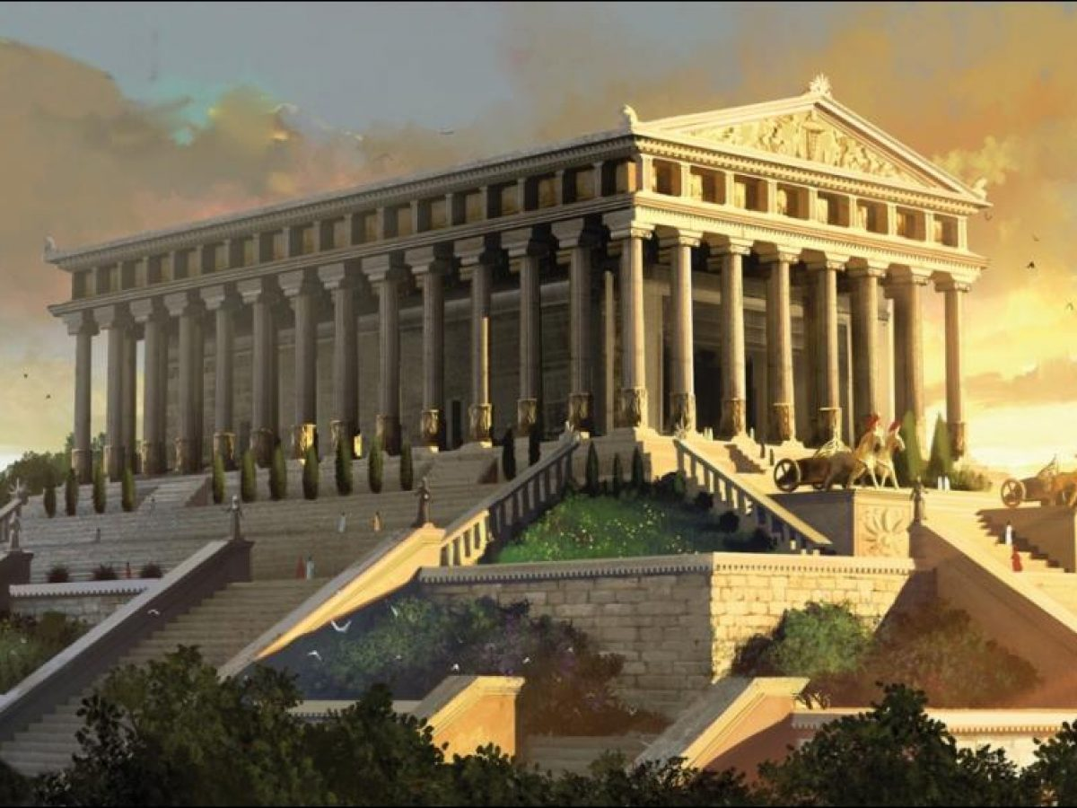

Slide 38
“Now this I say and testify in the Lord, that you must no longer walk as the Gentiles do…
Ephesians 4:17

Slide 39
“They… have given themselves up to sensuality, greedy to practice every kind of impurity. But that is not the way you learned Christ!”
Ephesians 4:19-20

Slide 40
“They… have given themselves up to sensuality, greedy to practice every kind of impurity. But that is not the way you learned Christ!”
Ephesians 4:19-20

Slide 41
ROOT OF ADDICTION
SOLUTION
The Sexualized Society
Pursue holiness
The Addicted Brain
Renew the mind
Isolation
Develop authentic relationships
Negative Emotions
Process emotions and grow EQ
Shame
Live out of identity in Christ
Trauma
Replace lies with truth

Slide 42
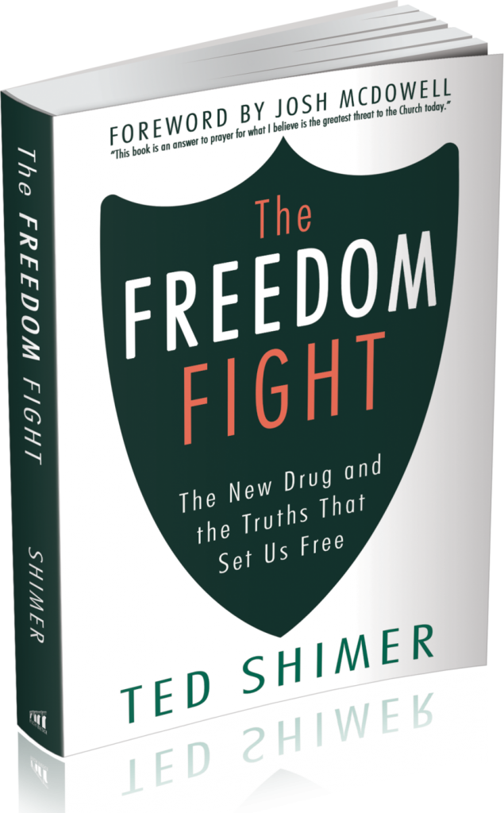

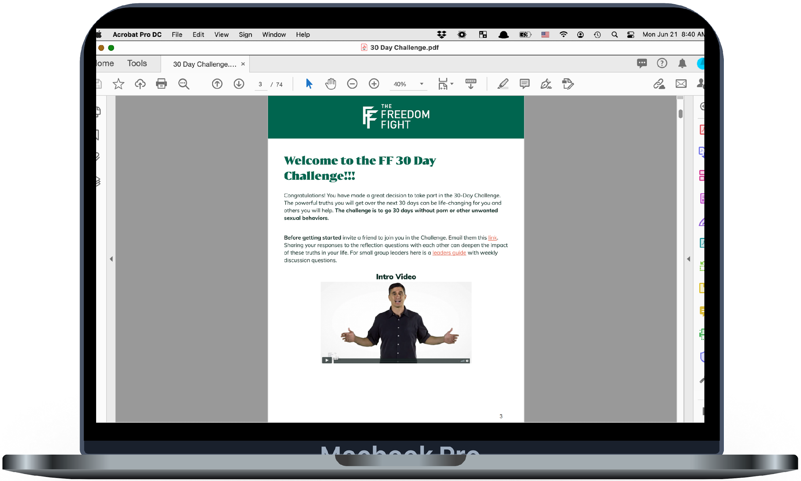
Our Solution
50+ videos, bible studies, and addiction-recovery tools for practical application
Biblically-based, scientifically informed, gospel centered approach
Users stay connected and accountable through app tools and check-ins

Slide 43

Unique Approach
The unique blend of biblical and therapeutically sound principles address the six roots of a porn/sex addiction.
Root of Addiction Solution/Area of Growth (Ephesians 4:17-27)
Sexualized society Holiness
Addicted Brain Renewing the mind
Isolation Authentic Accountability
Negative Emotions Processing emotions w/ God & others
Shame Live out of Identity in Christ
Trauma Replacing lies with truth
You don't just quit a porn addiction — you must outgrow it.

Slide 44
find freedom
when they finish the program and are committed to its 3 core habits
86%
“My team has evaluated over 100 different porn addiction recovery resources, and they have concluded that the Freedom Fight is the best online addiction program in the world. “
- Josh McDowell, Author and Speaker
I’ve been addicted to porn for 15 years and I actively tried for many years to break free. It wasn’t until I joined a Freedom Fight course offered through my church that I began experiencing freedom. I’d never before come across a more well -rounded and comprehensive recovery program as Freedom Fight. God has used Freedom Fight to transform my walk with Him. I’ve now had seven months of abstinence from porn and am helping other men find freedom as well. ⎼ David
more testimonies >>

Slide 45
Pastor’s Toolkit
thefreedomfight.org
The Freedom Fight Program
Leader’s Guide
The FF Book
The 30 Day Challenge
An Opportunity for Deep Discipleship

Slide 46
“Let us also lay aside every weight, and sin which so easily entangles, and let us run with endurance the race that is set before us.”
Hebrews 12:1

